Slide 1
Presentation Title : Mobility Monitor using MATLAB
Team members:
Polepalli Venkata Surya Charith, B.Tech(ECE), II year
Narayanan G ,SASHE(M.Sc.,Data Science), II year
Prasanth M ,SASHE(M.Sc.,Data Science), II year
Hariharan M,SASHE(M.Sc.,Data Science), II year
Swarna varsha B,SASHE(M.Sc.,Data Science), II year
Thirumalaivasan K, SASHE(M.Sc.,Data Science), II year
Dhivya Sri M,SASHE(M.Sc.,Data Science), II year
Shabarisri M,SASHE(M.Sc.,Data Science), II year

Slide 2
Project Presentation
Data gathering:
We were already collected data on walking , running, sitting and driving using the Matlab mobile Application.
Using the sensors in the app, we have recorded all the data for classification purposes.
Sample data loaded from ‘waldata.mat’
Installed MATLAB mobile app with access to device sensors such as Microphone, Acceleration, Magnetic Field, Orientation, Angular Velocity, Position.
Real-time monitoring that continuously record data from sensors
Uploaded the data to MATLAB Cloud for processing and analysis
It is stored in MATLAB driver so it is easy to work

Slide 3
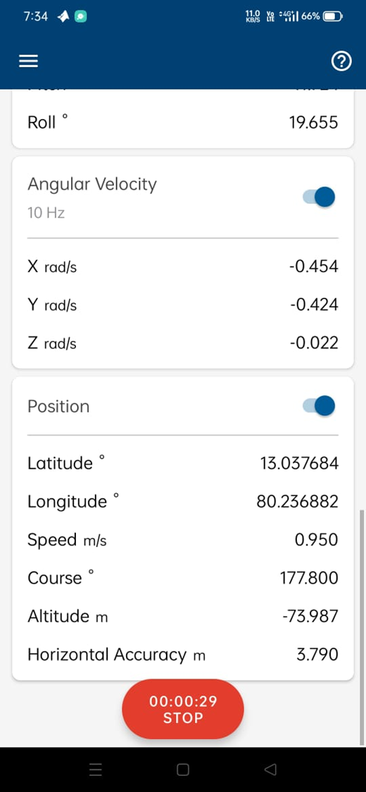
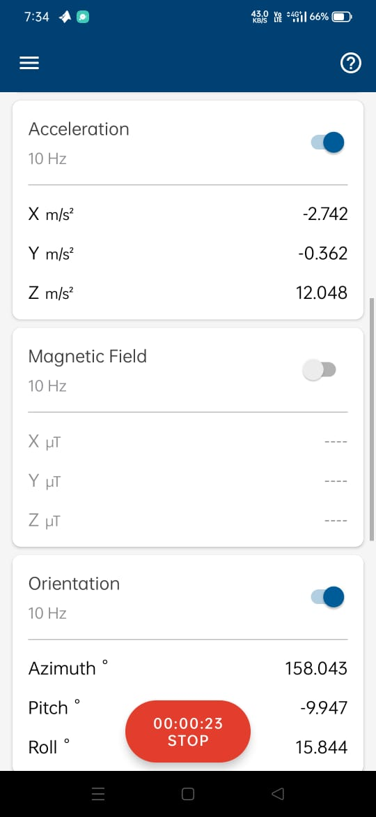
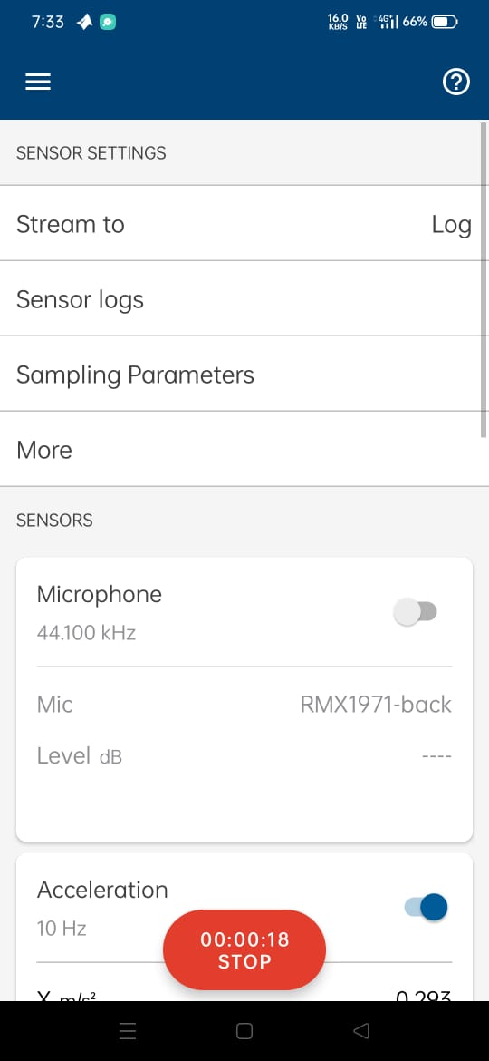

Slide 4
Displayed variables:
Latitude & Longitude:
Captures geographic coordinates, shown in map to illustrate movement paths
Timestamp
Indicates exact time of data capture and records the time for each set of acceleration data
Acceleration data
Measures acceleration along with X,Y & Z axes, displayed as graphs showing movement intensity overtime

Slide 5
Data analysis:
Total Distance travelled:
Calculated using geographic coordinates (latitude and longitude)
Number of Steps Taken:
Computed based on average stride length
Key Insights:
Distance Monitoring
Steps Count

Slide 6
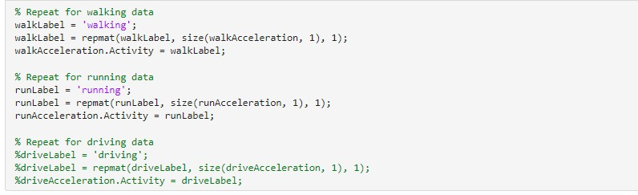
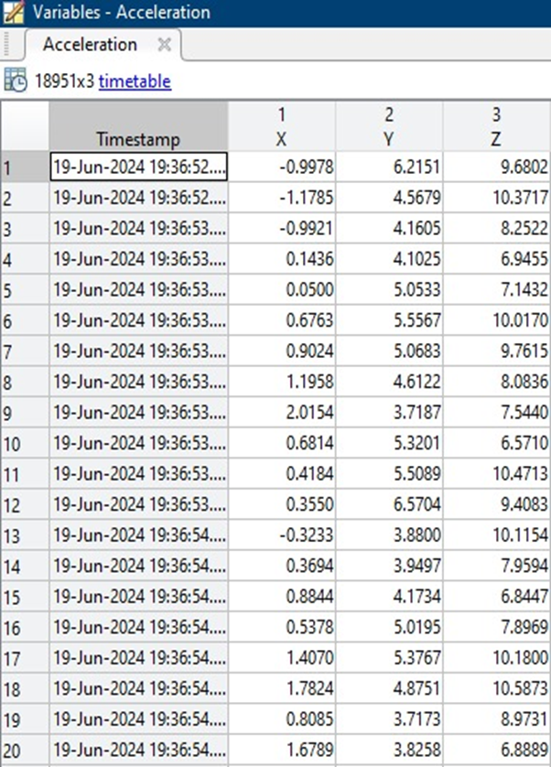
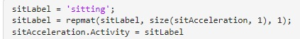

Slide 7
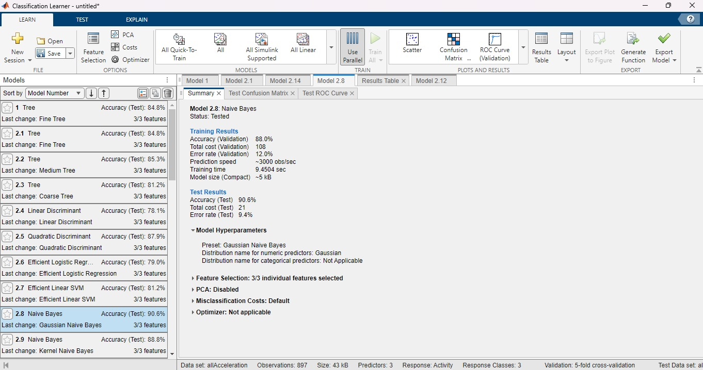
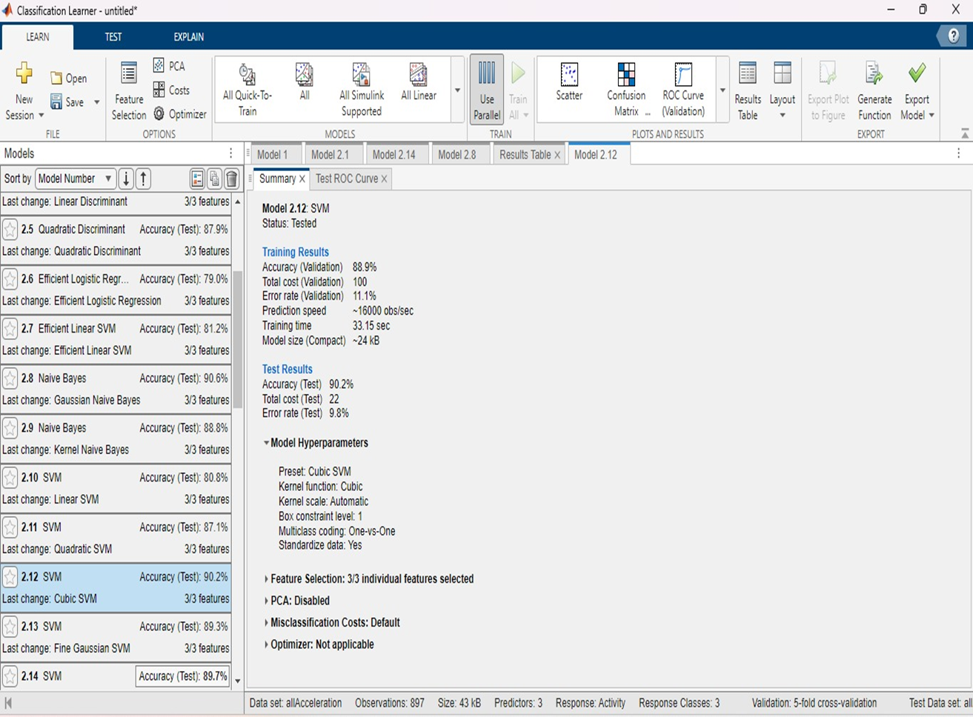

Slide 8
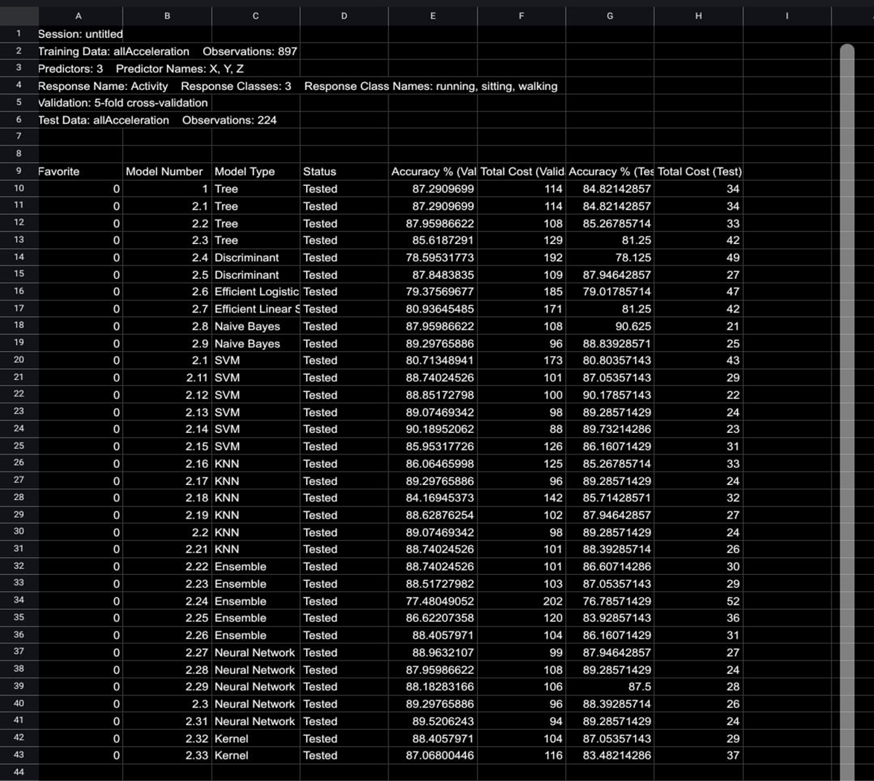
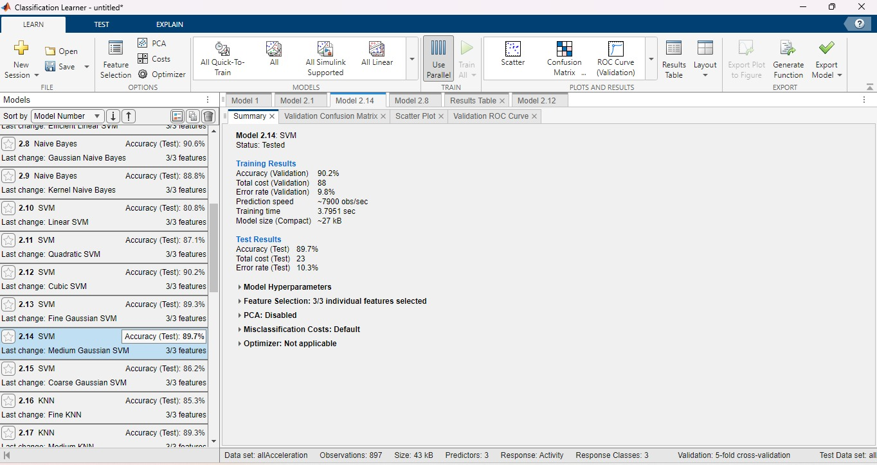

Slide 9
Results:
Activity classification: Classified activities based on accelerometer data.
Activities Included: Sitting, Walking, Running, Driving

Slide 10
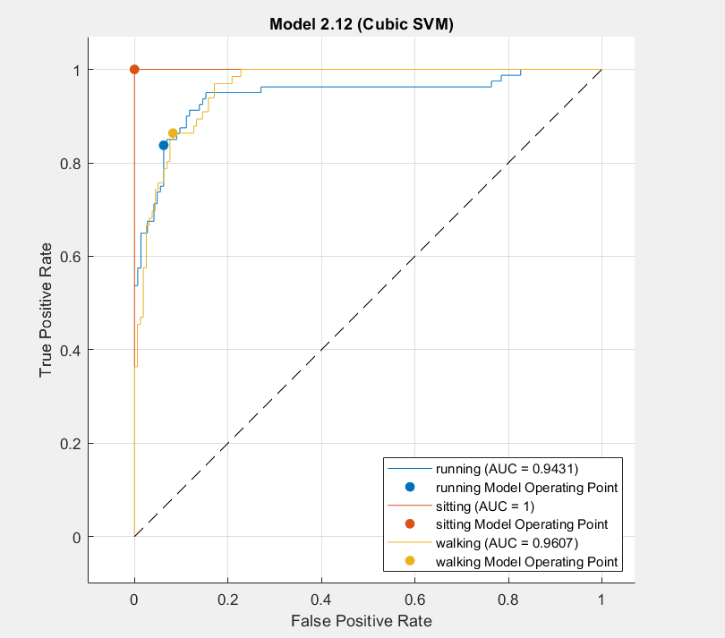
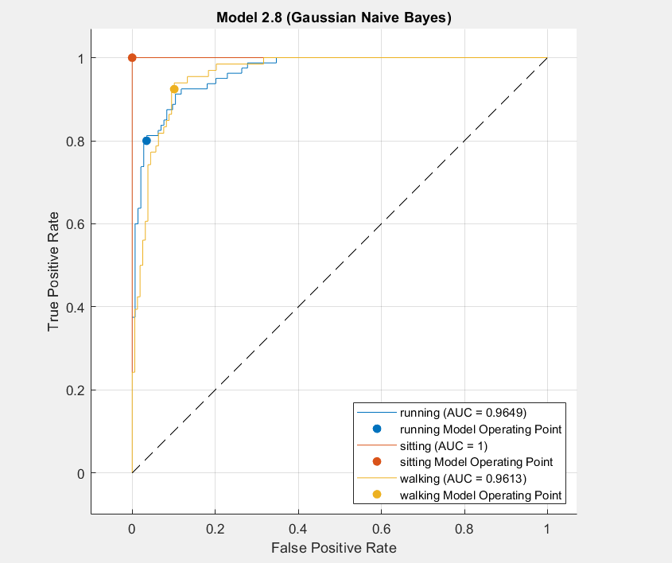
Roc Curve /Graphical Represntation:

Slide 11
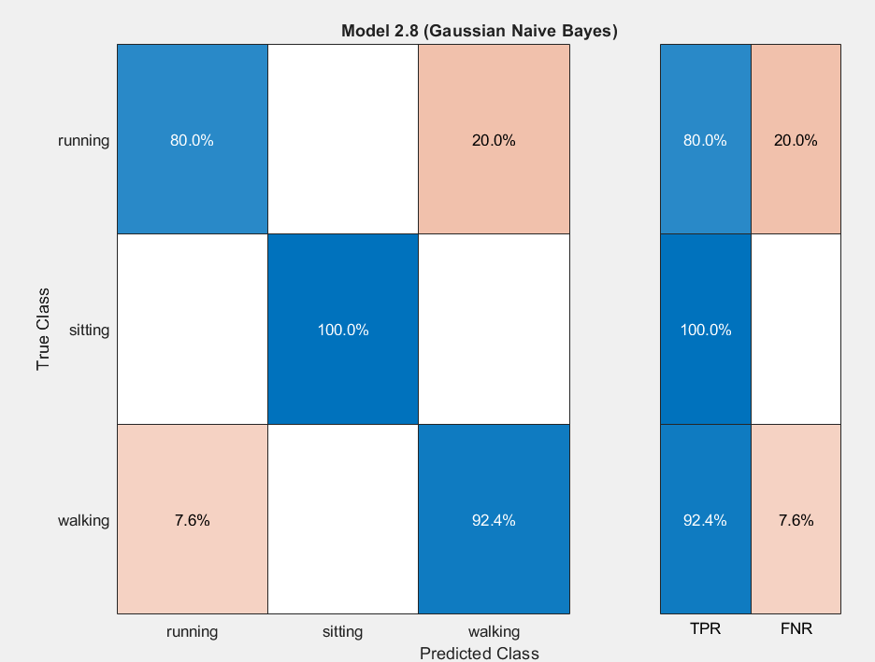
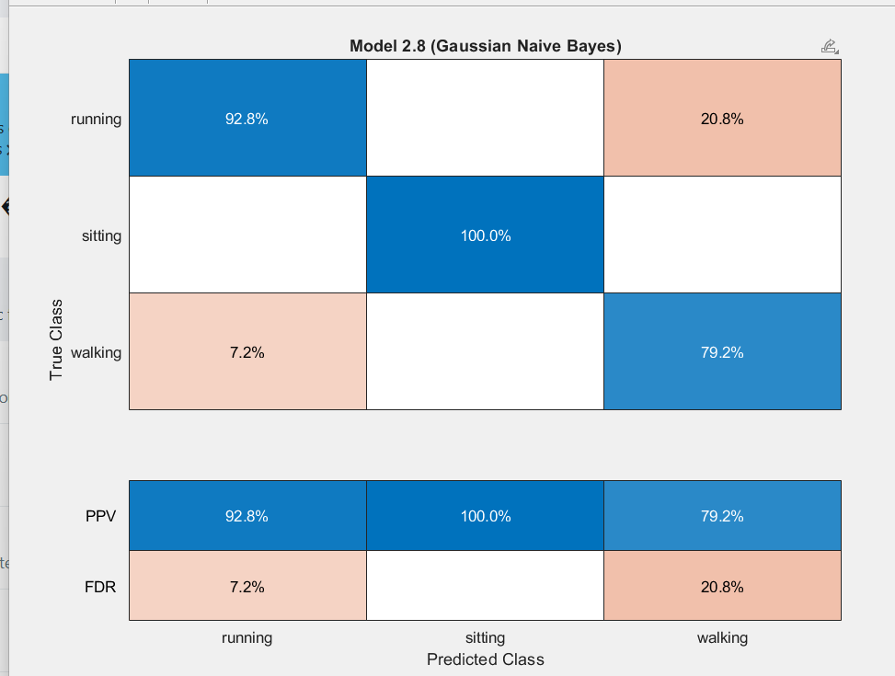
Confuse Matrixes:

Slide 12
Learnings, challenges and thoughts
Learnings
Effective use of geographic coordinates
Integrating Sensor Data
Steps calculation based on Stride
Feedback on the experience
Successfully implemented data collection , analysis and visualization using geographic coordinates and accelerometer data.
How do you want to take this forward
Implement alerts for anomalous activities or health concerns based on sensor data analysis

Slide 13
Onramp Submissions
Team Details | MATLAB Onramp Certificate Link | Machine Learning Onramp Certificate Link | Deep Learning Onramp Certificate Link
Polepalli Venkata Surya Charith B.Tech(ECE) II year 226004076@sastra.ac.in | https://matlabacademy.mathworks.com/progress/share/certificate.html?id=c4659a18-11cc-402b-95ba-b57de70da3a7& | https://matlabacademy.mathworks.com/progress/share/certificate.html?id=5839358d-1767-46f7-a579-179a3f3ae1c3& | https://matlabacademy.mathworks.com/progress/share/certificate.html?id=83801957-8666-40d5-9b70-bc2ce22e59fe&
Dhivya Sri M M.Sc Data Science II year 124150011@sastra.ac.in | https://matlabacademy.mathworks.com/progress/share/certificate.html?id=2efbeead-3427-4db0-9801-1af4aa221115& | https://matlabacademy.mathworks.com/progress/share/certificate.html?id=7fe3b612-cc44-4de2-9e2c-397b53343365& | https://matlabacademy.mathworks.com/progress/share/certificate.html?id=24dc98cd-80f9-495b-829a-6f11afb04947&
Shabarisri M M.Sc Data Science II year 124150038@sastra.ac.in | https://matlabacademy.mathworks.com/progress/share/certificate.html?id=b8c0622a-7a80-4f1e-befb-d7fae9ba0451& | https://matlabacademy.mathworks.com/progress/share/certificate.html?id=24359828-fde8-476f-96d0-d44645adedc5& | https://matlabacademy.mathworks.com/progress/share/certificate.html?id=3d5b6159-6834-41eb-845f-f609fc5dada0&
Swarna varsha B M.Sc Data Science II year 124150054@sastra.ac.in | https://matlabacademy.mathworks.com/progress/share/certificate.html?id=a722d063-9782-45f9-9a84-6a9b8f47c82c& | https://matlabacademy.mathworks.com/progress/share/certificate.html?id=e04ae5c8-325a-4e50-adec-de52222abb07& | https://matlabacademy.mathworks.com/progress/share/certificate.html?id=a722d063-9782-45f9-9a84-6a9b8f47c82c&
Narayanan G M.Sc Data Science II year 124150031@sastra.ac.in | https://matlabacademy.mathworks.com/details/matlab-onramp/gettingstarted | https://matlabacademy.mathworks.com/details/machine-learning-onramp/machinelearning | https://matlabacademy.mathworks.com/details/deep-learning-onramp/deeplearning

Slide 14
Prasanth M M.Sc Data Science II year 124150033@sastra.ac.in | https://matlabacademy.mathworks.com/details/matlab-onramp/gettingstarted | https://matlabacademy.mathworks.com/progress/share/certificate.html?id=ea4a9af9-4abe-4c74-ac8f-e99ebdcd377d& | https://matlabacademy.mathworks.com/progress/share/certificate.html?id=fb20411a-66c2-47f5-b066-6630c64347c1&
Thirumalaivasan K M.Sc Data Science II year 124150048@sastra.ac.in | https://matlabacademy.mathworks.com/progress/share/certificate.html?id=0c050e8c-042e-4fd7-b658-2d90ca4353c7& | https://matlabacademy.mathworks.com/progress/share/certificate.html?id=701e24e1-5a9a-4d5e-8382-e43f6ec9f197& | https://matlabacademy.mathworks.com/progress/share/certificate.html?id=b77447eb-43a7-4cf2-89c0-b031fc802ced&
Hariharan M M.Sc Data Science II year 124150015@sastra.ac.in | https://matlabacademy.mathworks.com/progress/share/certificate.html?id=4a9c08df-0e67-4b54-8a1a-e8a68150cb70& | https://matlabacademy.mathworks.com/progress/share/certificate.html?id=4673a001-dbe5-4c2b-ab2d-9e289f0c391b& | https://matlabacademy.mathworks.com/progress/share/certificate.html?id=edd0133b-cf47-43ef-97b6-a765acbe48f8&

